Slide 1
Big data management
Project
Apavaloaei Eduard
matr.1057101

Slide 2
Main dataset and shape file:
Anagrafe_biblioteche_comunali_lombarde - Anno_2016(anagrafe_biblioteche.csv)*
Confini_amministrativi (Com01012023_WGS84.shp)**
Main purpose of the project: to get some insights of the libraries in Lombardia and their distribution throughout the territory.

Slide 3
PostgreSQL

Slide 4
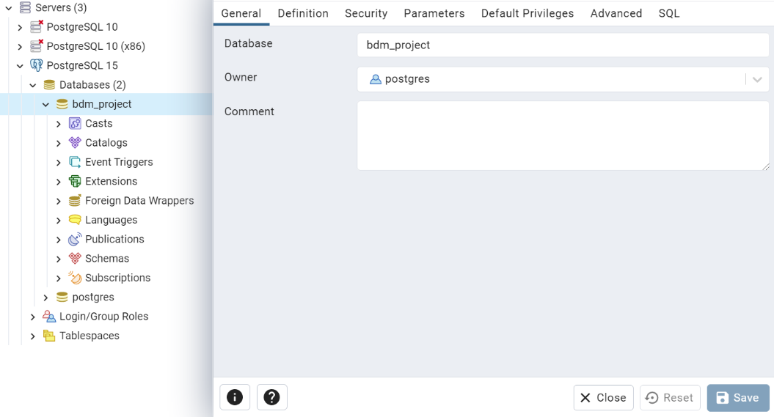

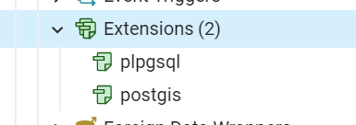
Database creation. Using PgAdmin4 I created a new database called “bdm_project” in the PostgreSQL 15 server.
Then, knowing that I’ll use it later, I added the Postgis extension.

Slide 5
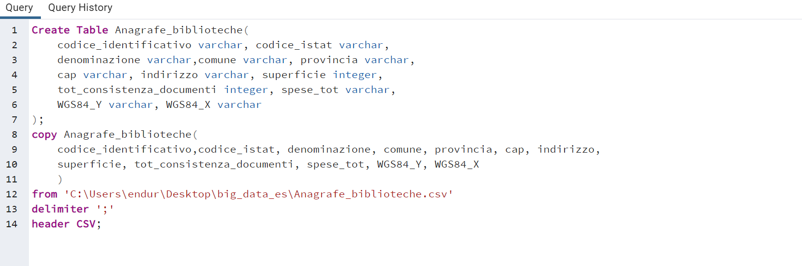
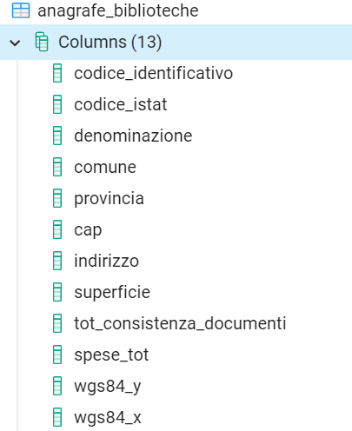
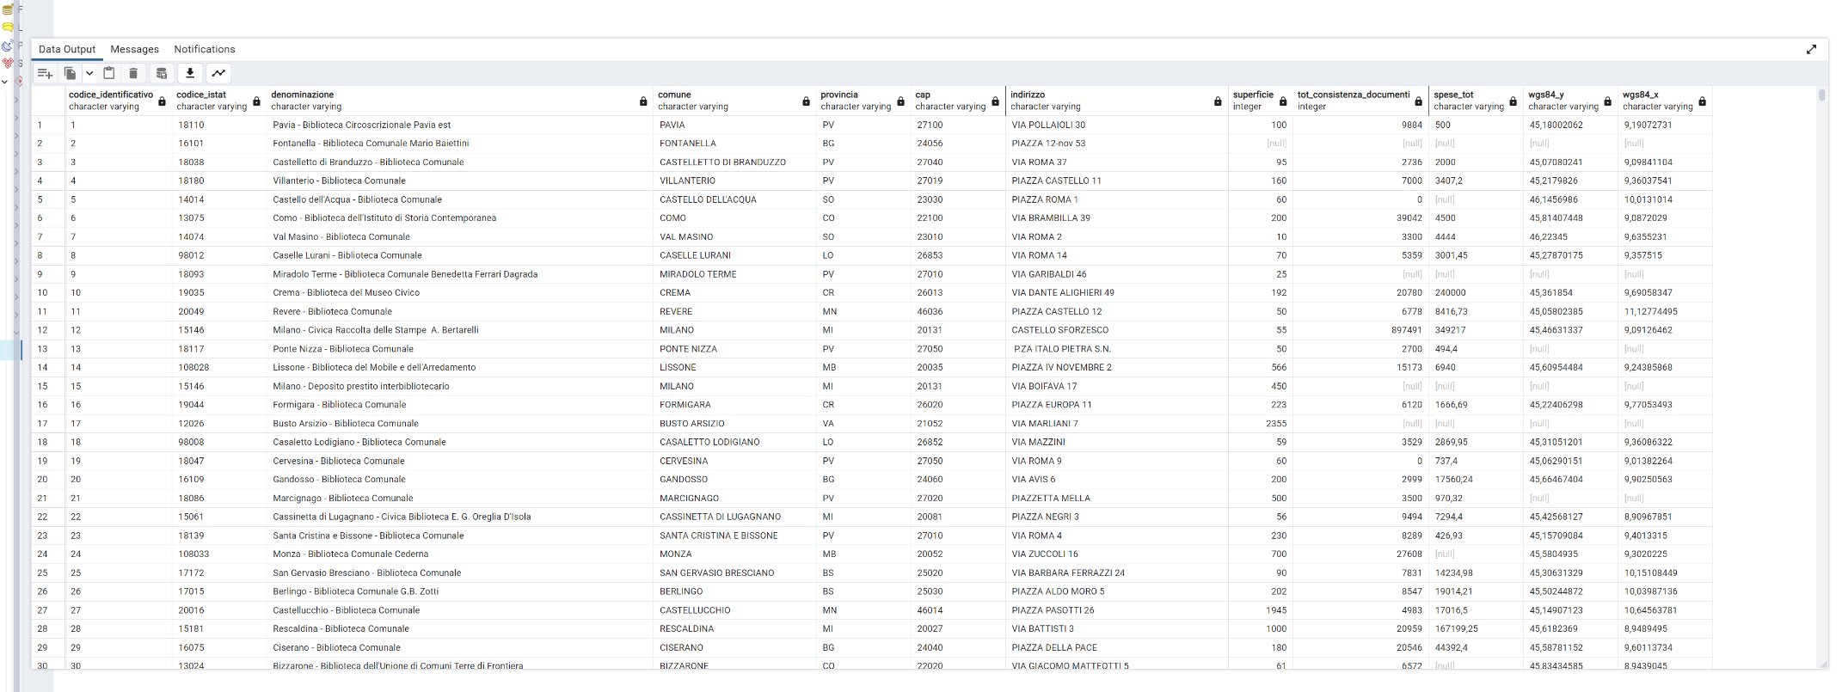
I continued with the creation and population of the table.
The table has some drawbacks, like null values or repeated values.

Slide 6
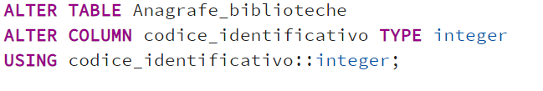
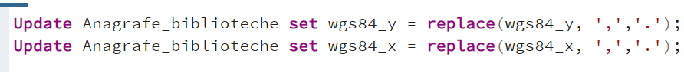
So, I proceeded by cleaning the data in the table:
I changed the type of the primary key.
I deleted all null values.
In the two coordinates columns, there were values with the comma, so I replaced them with dots. This will be useful later, when I’ll transform the values in this columns in geometric data.

Slide 7
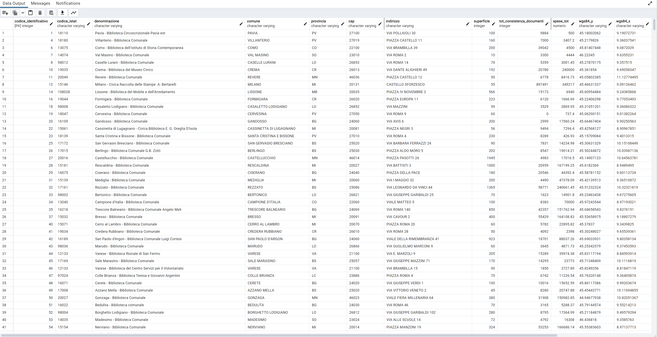
The clean table:

Slide 8
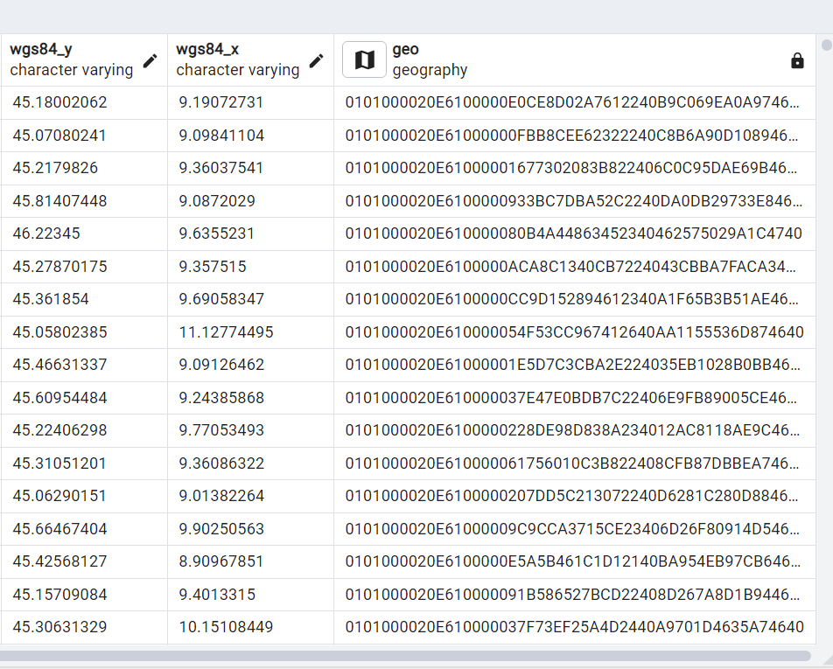
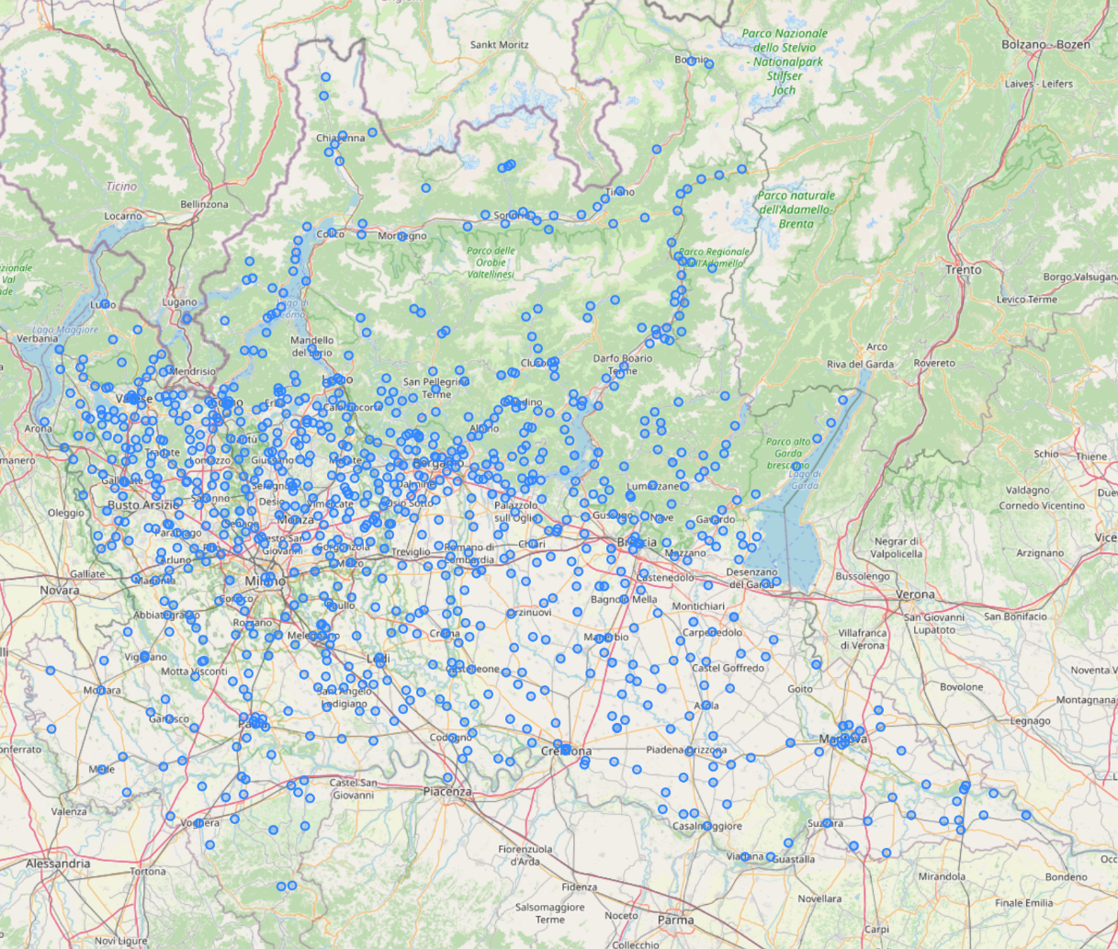
Coordinates transformation:

Slide 9
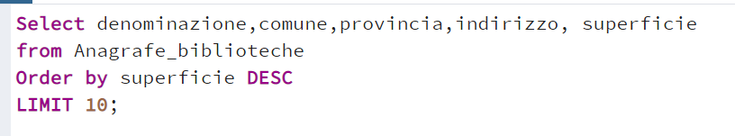
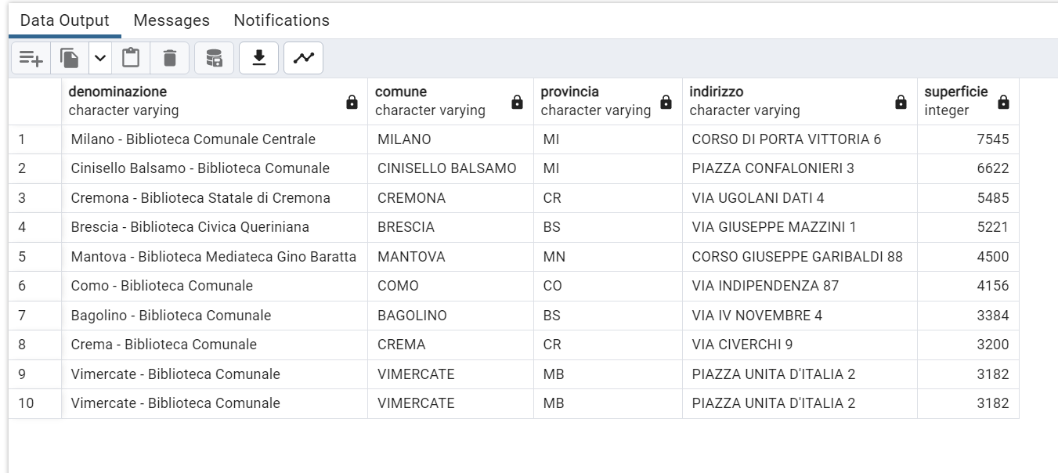
Query 1: Select and visualize the top ten, by surface area, libraries in Lombardia.

Slide 10
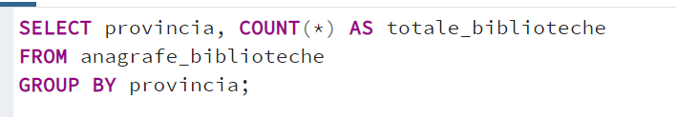
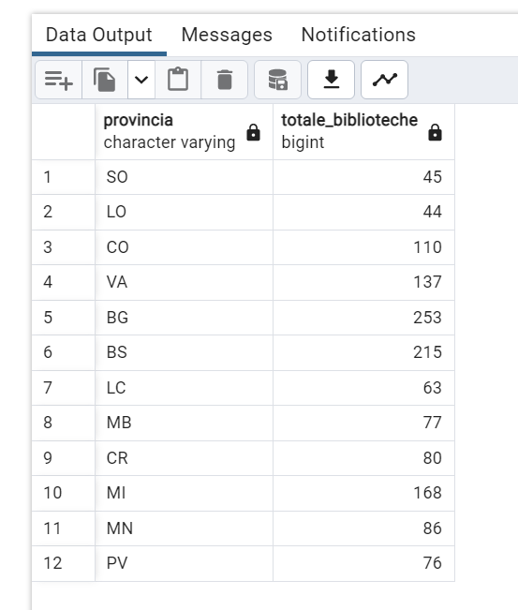
Query 2: Select and visualize the total number of libraries in Lombardia, grouped by province.

Slide 11
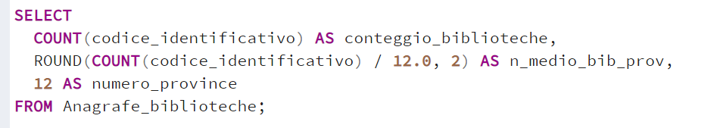
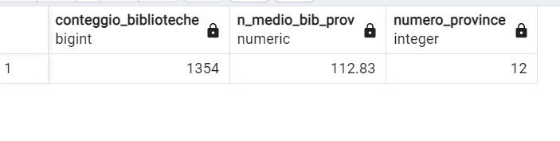
Query 3: Select and visualize the average number of libraries, by province, in Lombardia.

Slide 12
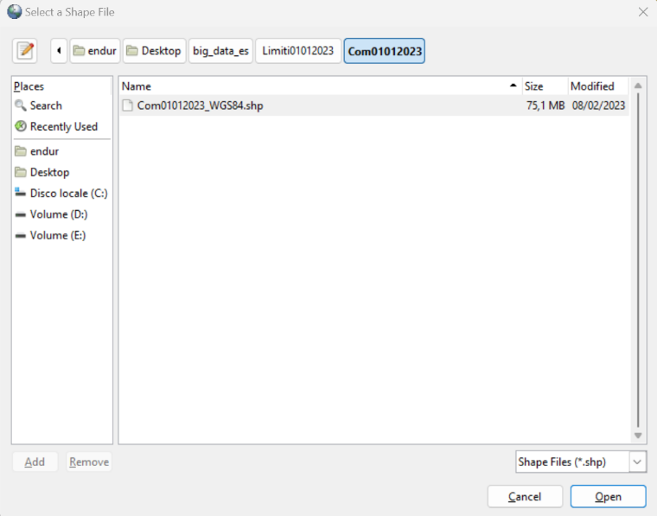
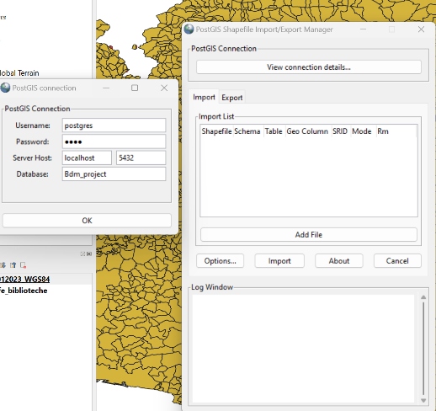
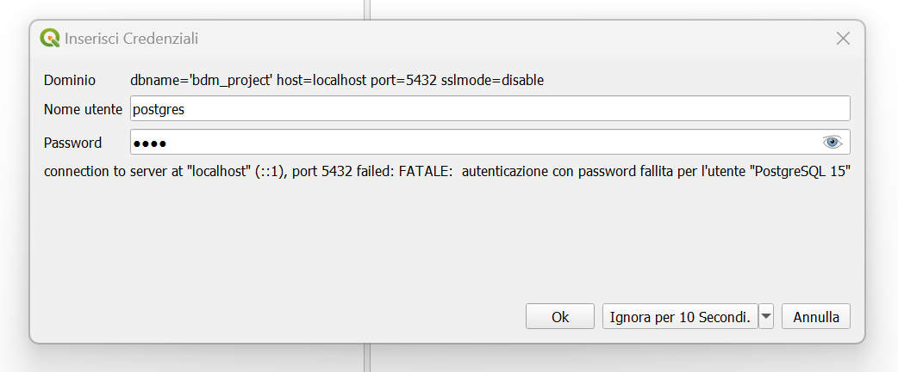
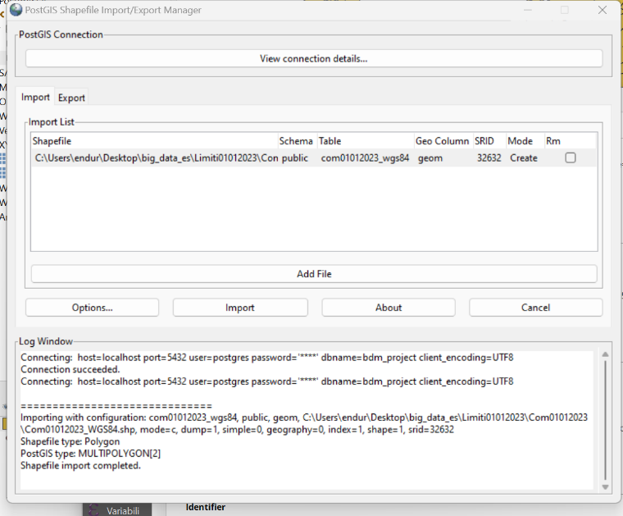
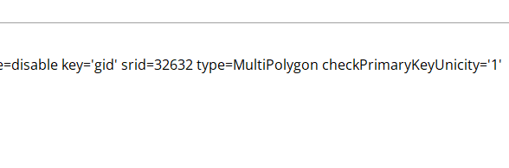
QGIS: Connection to PostgreSQL and import of the new shape file – Com01012023.shp- administrative boundaries of Italian municipalities.
Making sure that the SRID is the same: 32632

Slide 13
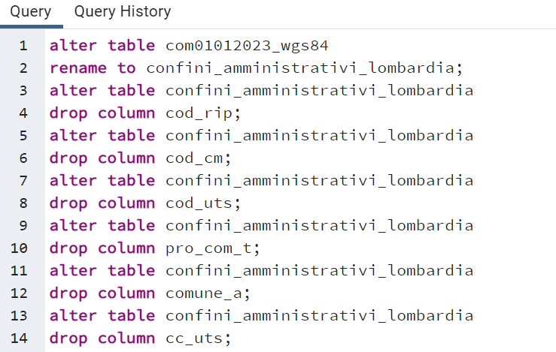
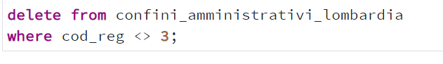
Renaming and cleaning the new dataset, keeping only the boundaries of the Lombard municipalities

Slide 14
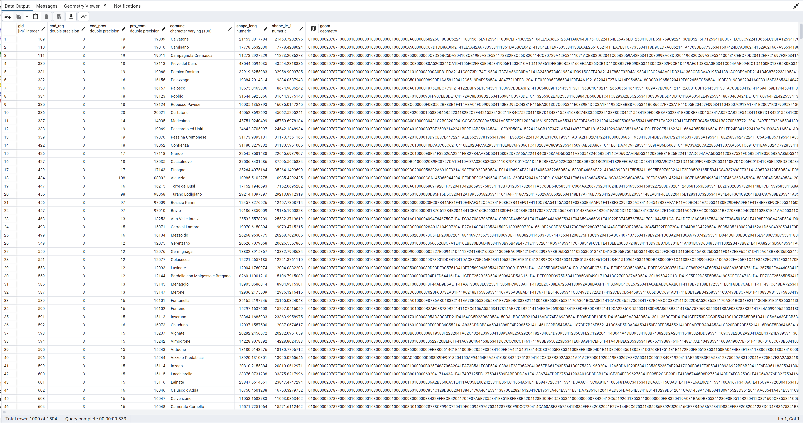
Clean table

Slide 15
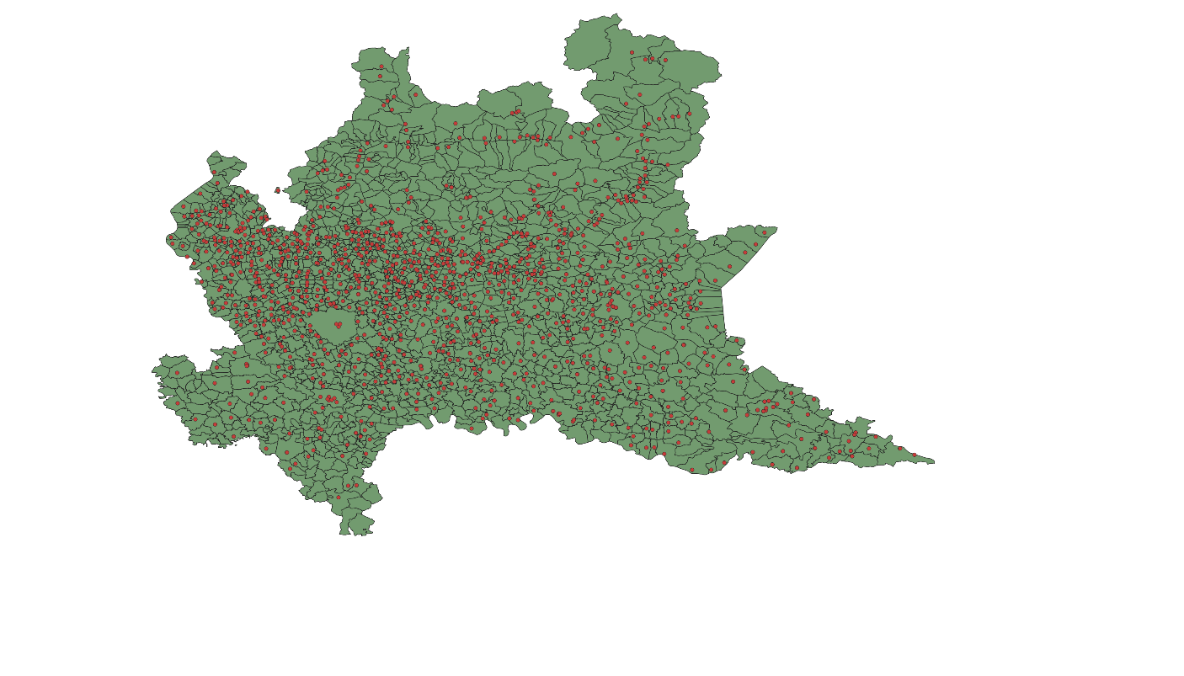
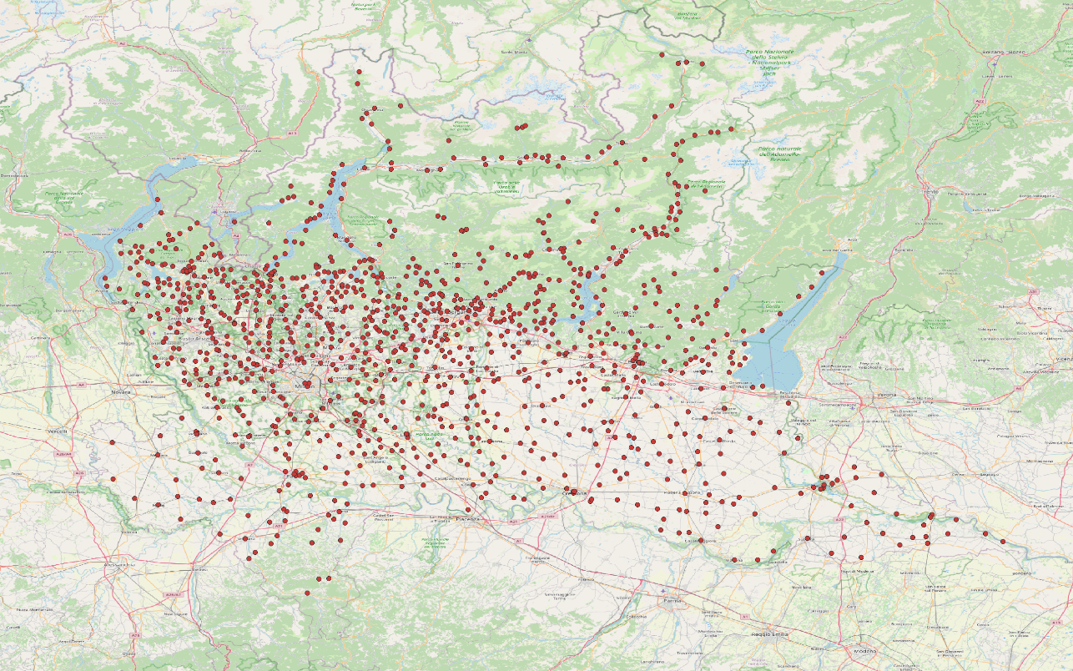
Adding the “anagrafe biblioteche” layer first to “confini_amminisitrativi_lombardia” then to OpenStreetMap.

Slide 16
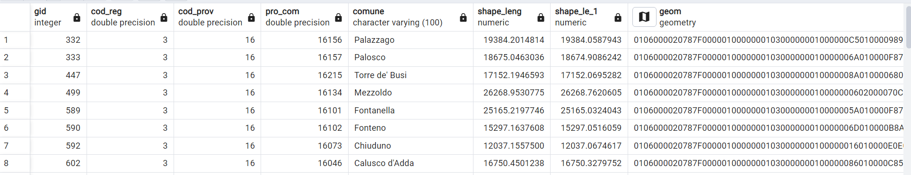
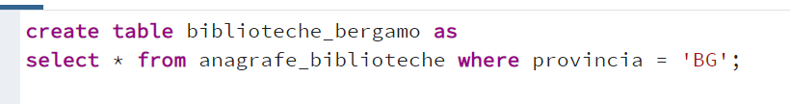
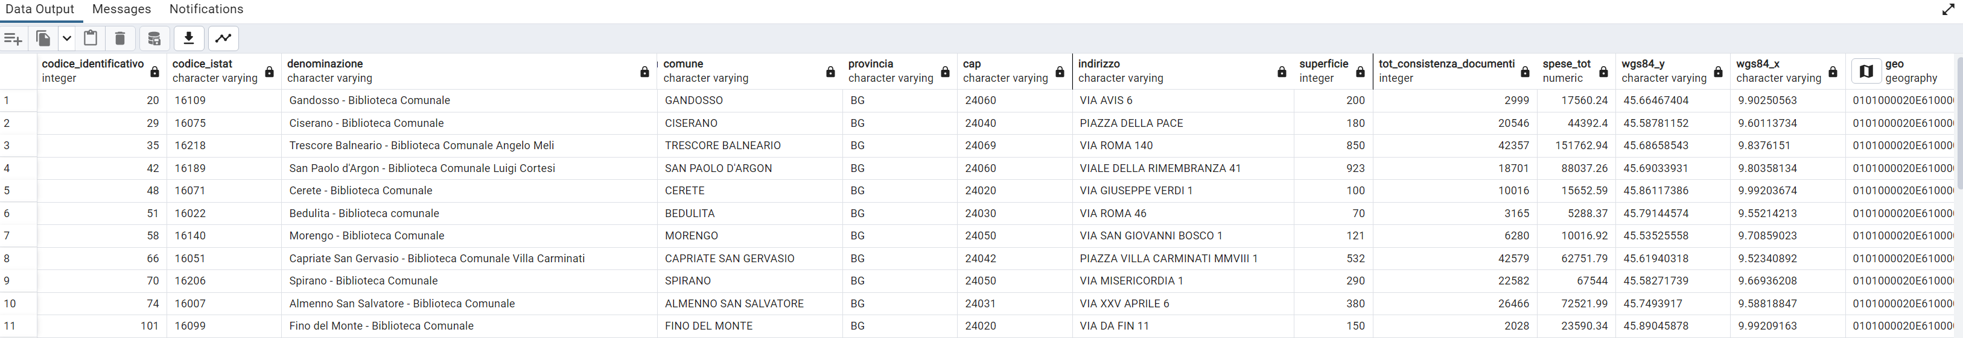
Starting from the existing tables, I created two more tables concerning only the province of Bergamo.

Slide 17
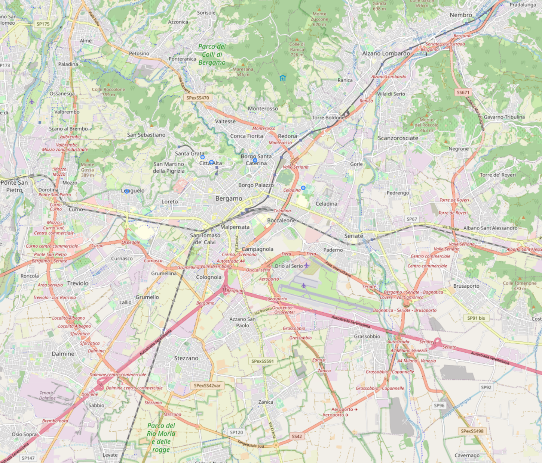
Query: Select and visualize on the map only the libraries in Bergamo.

Slide 18
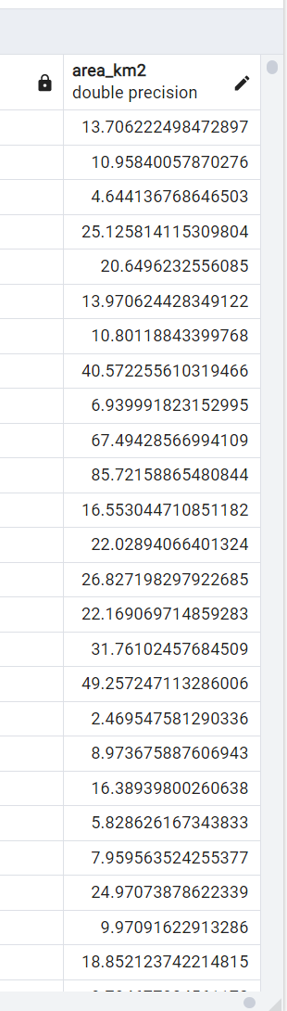
In order to implement spatial queries using PostGIS I created another column, area_km2, in the “confini_amministrativi_lombardia” table.
This column contains the geographical extension of the Lombard municipalities, in square kilometres.

Slide 19
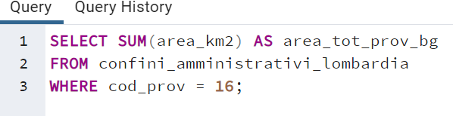
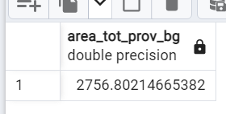
Query 1: Find the total extension of the province of Bergamo.

Slide 20
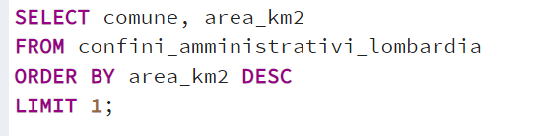
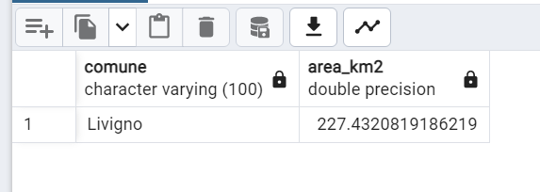
Query 2: Find the largest municipality in Lombardia.

Slide 21
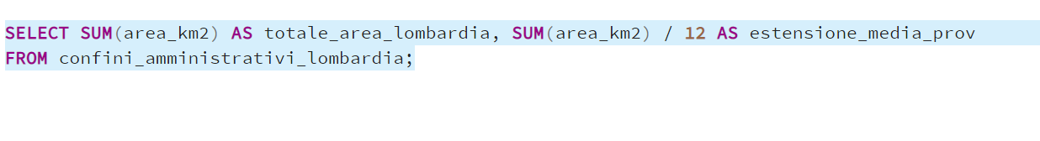
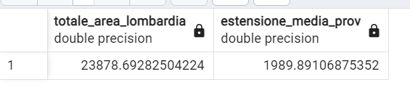
Query 3: Find the total extension of Lombardia region and the average extension of a Lombard municipality.

Slide 22
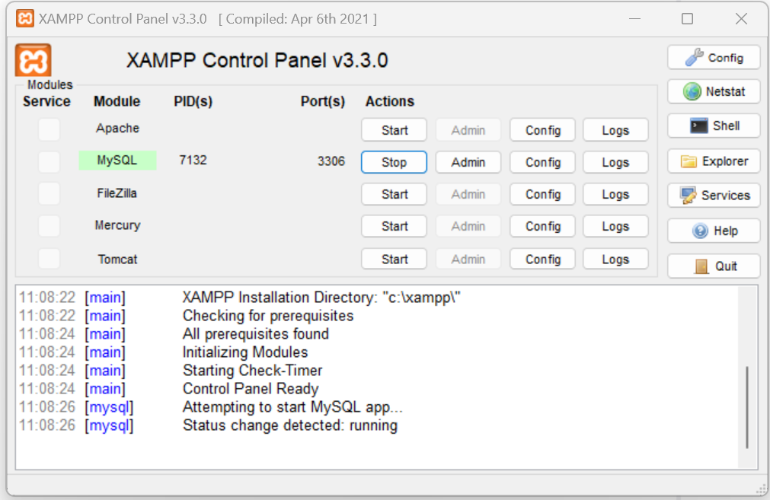

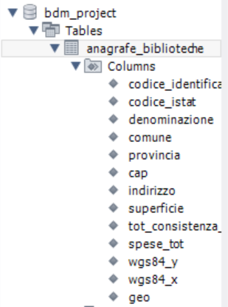
After starting the MySQL server connection through XAMPP, I used MySQLWorkebench to create a new database “bdm_project”.

Slide 23
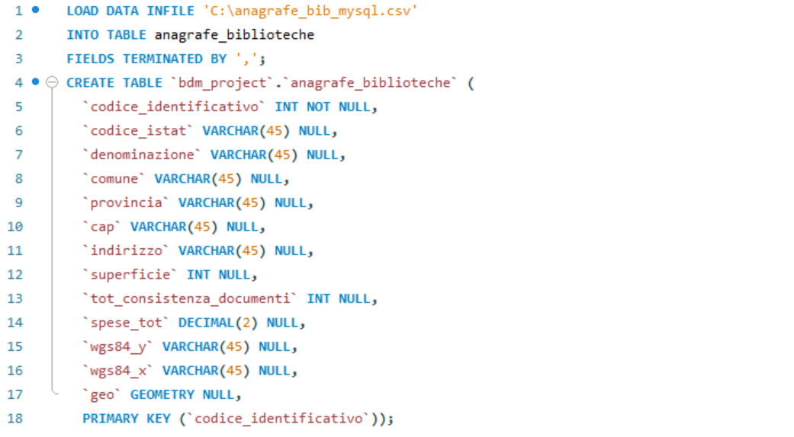
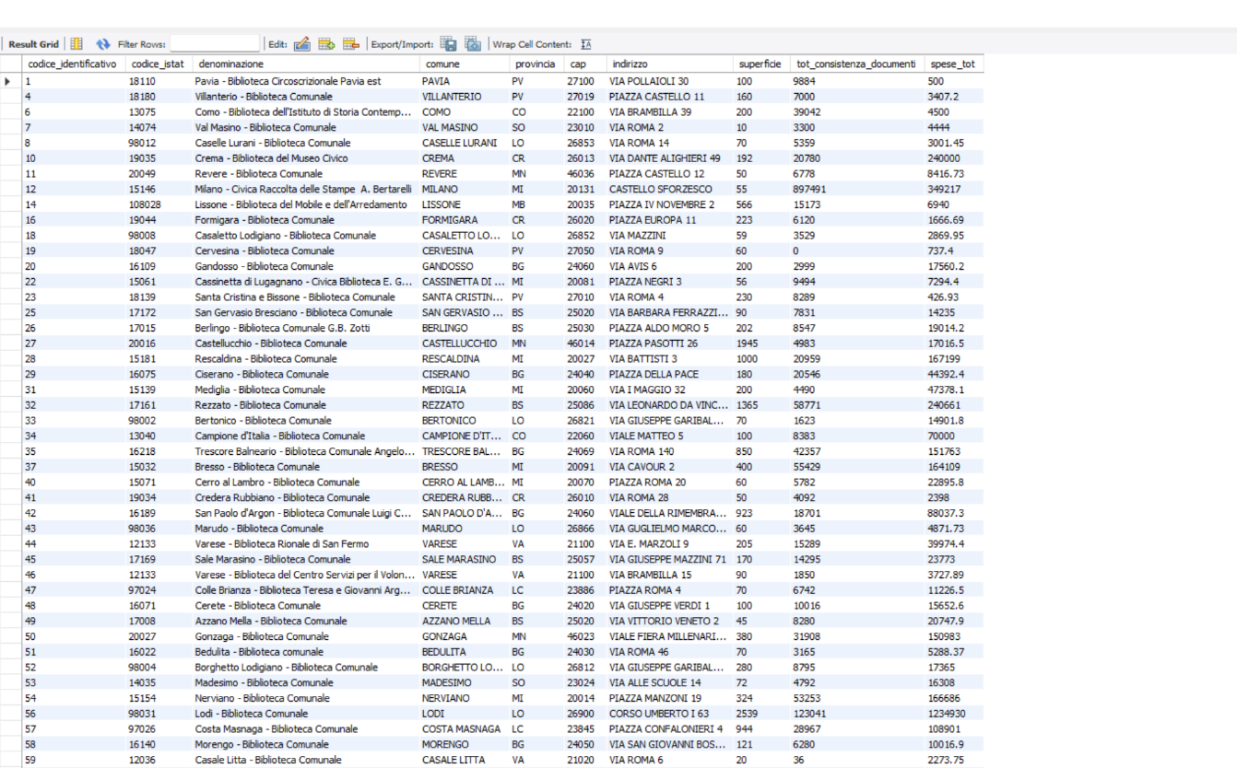
Then I created a new table “anagrafe_biblioteche” and imported the data.

Slide 24
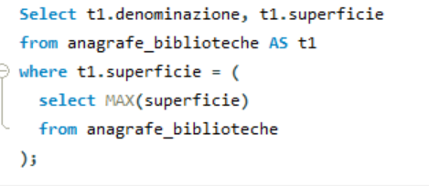
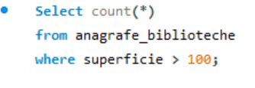
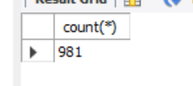
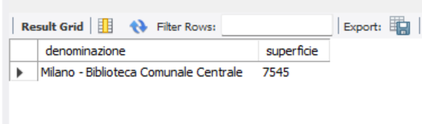
Query 1: Count how many libraries are bigger than 100 m2.
Query2: Select the biggest library in Lombardia.

Slide 25
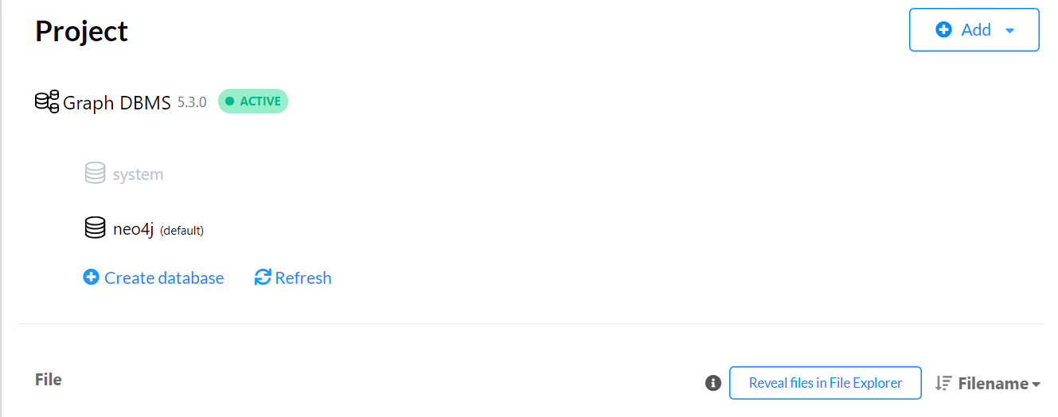
Neo4j
Datasets used: “Airports”-”airports.csv”***; “Flights”-”flights.csv”****.
Database used: neo4j.

Slide 26
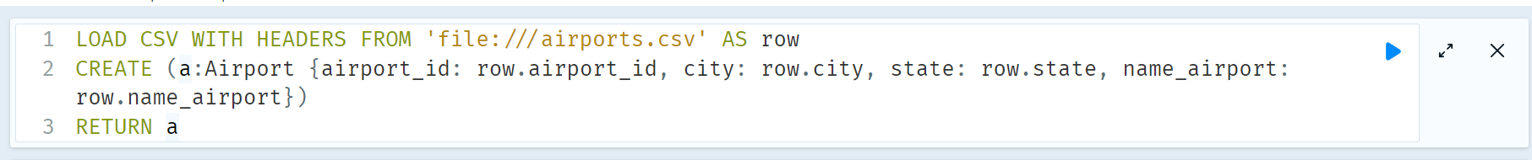
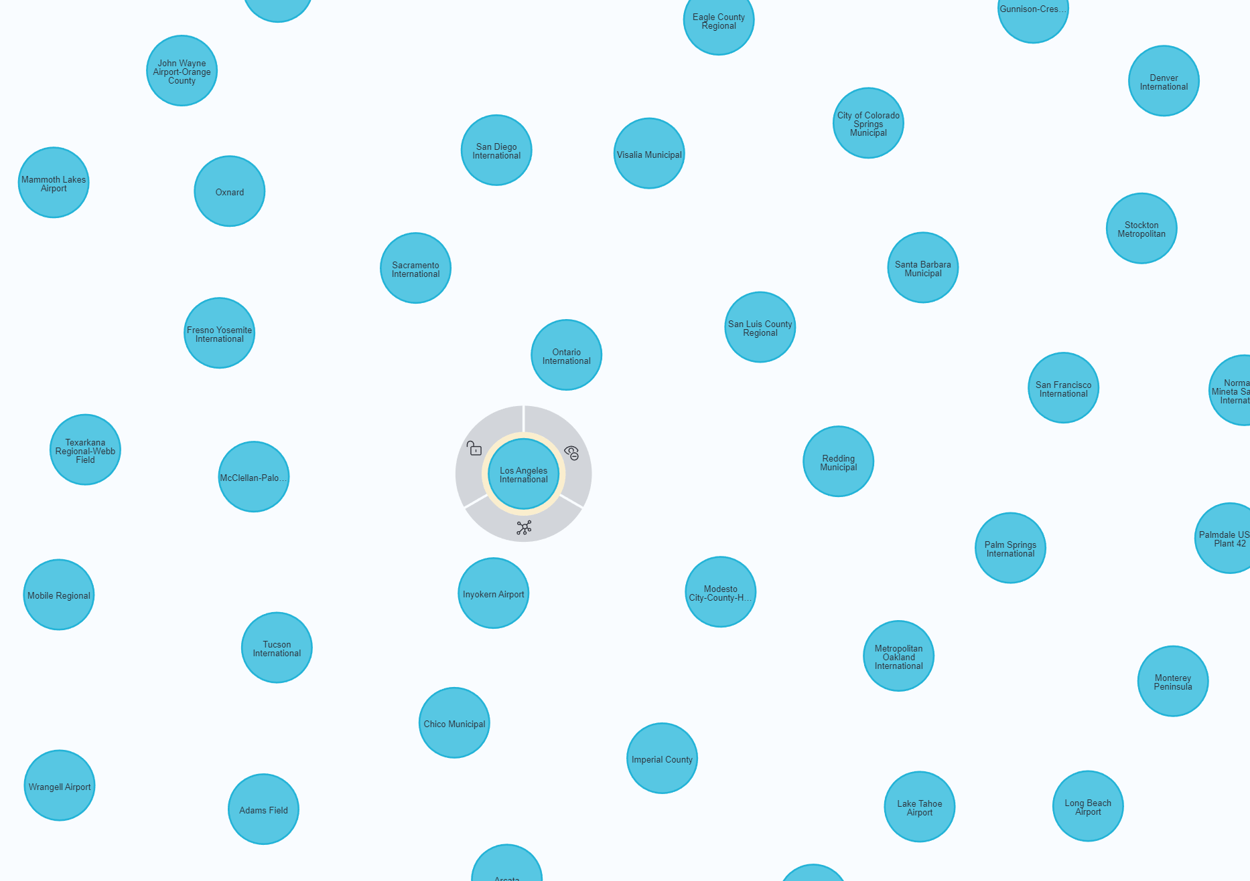
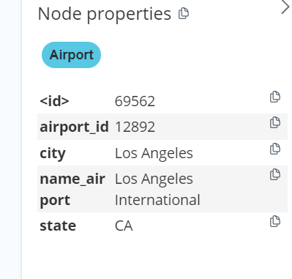
Implementation of the dataset“airports”.

Slide 27

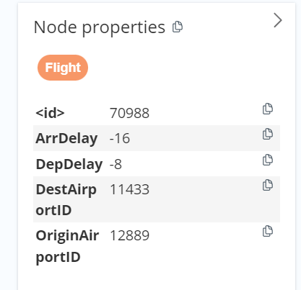
Implementation of the dataset “flights”

Slide 28


Relationships

Slide 29

Query 1: Count all flights that depart from a certain airport.

Slide 30


Query 2: Select all the airports in New York.

Slide 31

Query 3: Calculate the percentage of flights than have been delayed for more than thirty minutes

Slide 32


Over pass-turbo: universities

Slide 33


Over pass-turbo:fast-food restaurants

Slide 34


Power BI. Dataset used: “Anagrafe_biblioteche.csv”, the same as before.****

Slide 35

Table used

Slide 36



Slide 37



Slide 38
Datasets:
* https://www.dati.lombardia.it/Cultura/Anagrafe-biblioteche-comunali-lombarde-Anno-2016/k2xm-fcgg
** https://www.istat.it/it/archivio/222527
*** https://www.kaggle.com/datasets/tylerx/flights-and-airports-data?resource=download&select=airports.csv
**** https://www.kaggle.com/datasets/tylerx/flights-and-airports-data?resource=download&select=flights.csv
**** Due to a problem with the connection between Power BI and PostgreSQL I loaded directly the dataset «anagrafe_biblioteche.csv»

